Slide 1
Overview
Adder
Ripple Carry Adder
Subtraction
Adder/Subtractor

Slide 2
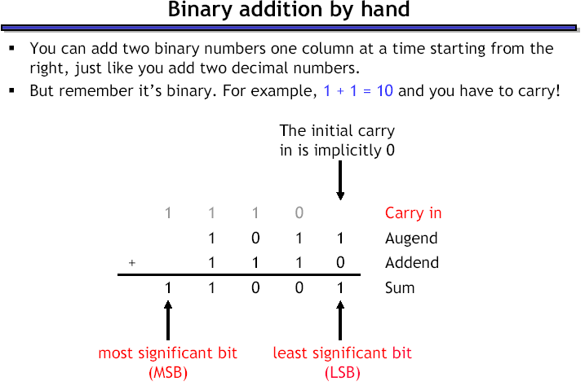

Slide 3
Adder
Design an Adder for 1-bit numbers?
1. Specification: 2 inputs (X, Y) 2 outputs (C,S)

Slide 4
Adder
Design an Adder for 1-bit numbers?
1. Specification: 2 inputs (X,Y) 2 outputs (C,S)
2. Formulation:
X | Y | C | S
0 | 0 | 0 | 0
0 | 1 | 0 | 1
1 | 0 | 0 | 1
1 | 1 | 1 | 0

Slide 5
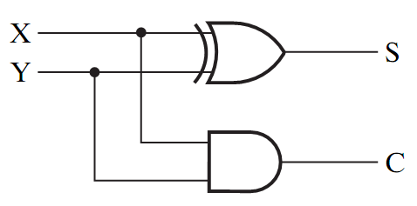
Adder
Design an Adder for 1-bit numbers?
1. Specification: 3. Circuit 2 inputs (X,Y) 2 outputs (C,S)
2. Formulation:
X | Y | C | S
0 | 0 | 0 | 0
0 | 1 | 0 | 1
1 | 0 | 0 | 1
1 | 1 | 1 | 0

Slide 6
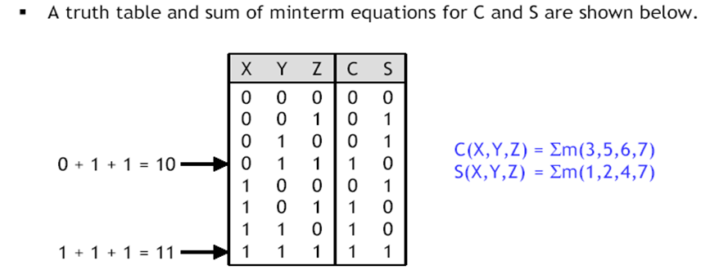
Full Adder
A combinational circuit that adds 3 input bits to generate a Sum bit and a Carry bit

Slide 7
Full Adder
A combinational circuit that adds 3 input bits to generate a Sum bit and a Carry bit
X | Y | Z | C | S
0 | 0 | 0 | 0 | 0
0 | 0 | 1 | 0 | 1
0 | 1 | 0 | 0 | 1
0 | 1 | 1 | 1 | 0
1 | 0 | 0 | 0 | 1
1 | 0 | 1 | 1 | 0
1 | 1 | 0 | 1 | 0
1 | 1 | 1 | 1 | 1
S = X’Y’Z + X’YZ’ + XY’Z’ +XYZ
= X ⊕ Y ⊕ Z
C = X’YZ + XY’Z + XYZ’ + XYZ
=(X’Y + XY’). Z + XY (Z’ + Z)
=(X ⊕ Y)Z + XY

Slide 8
Full Adder = 2 Half Adders
Manipulating the Equations:
S = (X ⊕ Y) ⊕ Z
C = (X ⊕ Y )Z + XY

Slide 9
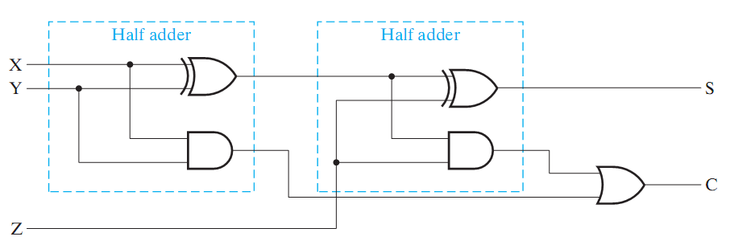
Full Adder = 2 Half Adders
Manipulating the Equations:
S = ( X ⊕ Y ) ⊕ Z
C = (X ⊕ Y )Z + XY
Think of Z as a carry in
Src: Mano’s Book

Slide 10
Bigger Adders
How to build an adder for n-bit numbers?
Example: 4-Bit Adder
Inputs ?
Outputs ?
What is the size of the truth table?
How many functions to optimize?

Slide 11
Bigger Adders
How to build an adder for n-bit numbers?
Example: 4-Bit Adder
Inputs ? 9 inputs
Outputs ? 5 outputs
What is the size of the truth table? 512 rows!
How many functions to optimize? 5 functions

Slide 12
Ripple Carry Adder
To add n-bit numbers:
Use n Full-Adders
The carries propagates as in addition by hand
Use Z in the circuit as a C_{in}
1 0 0 0
0 1 0 1
0 1 1 0
1 0 1 1

Slide 13
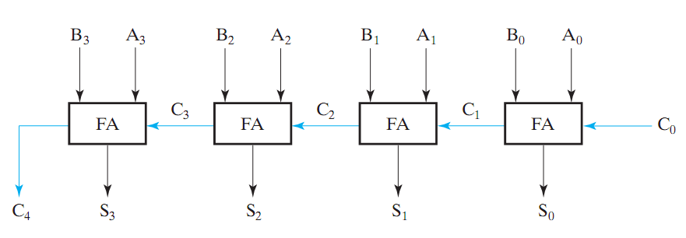
Ripple Carry Adder
To add n-bit numbers:
Use n Full-Adders
The carries propagates as in addition by hand
Src: Mano’s Book
This adder is called a 4-bit ripple carry adder

Slide 14
Subtraction (2’s Complement)
How to build a subtractor using 2’s complement?

Slide 15
Subtraction (2’s Complement)
How to build a subtractor using 2’s complement?
1
Src: Mano’s Book
S = A + ( -B)

Slide 16
Adder/Subtractor
How to build a circuit that performs both addition and subtraction?

Slide 17
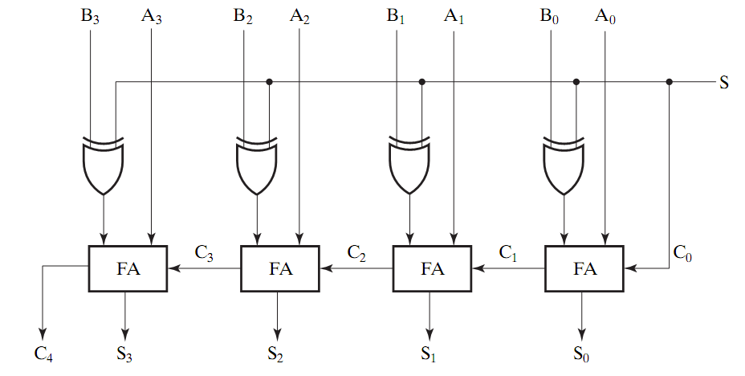
Adder/Subtractor
0 : Add
1: subtract
Src: Mano’s Book
Using full adders and XOR we can build an Adder/Subtractor!

